Slide 2
Let me introduce ourselves

Slide 3
Our organization
The Board since May 2022...
and our newest Treasurer...

Slide 4
Our organization
and our lovely Team Members...

Slide 5
Our work and goals
We have two main goals...
To make this semester unforgettable for you
To help you
DO WE DO THAT?

Slide 6
We offer our help to you...
...through our mentors...
they are the volunteers of ESN ELTE who are there to help you with any questions regarding the university, its system/questions about the city, transportation, restaurants, bars... and anything else that you might need as exchange students
you can get mentors through an app called Papaya --» specific instructions: our Instagram page: esnelte
they help facilitating events and happenings of the organization

Slide 7
We want to make your stay here unforgettable...
...through our events and happenings...
We organize 2-3 events a week including parties, social events, hikes, bath afternoons, quizes etc...
We have ESNcard that grants you discounts for events, for certain services provided by e.g. Ryanair, Flixbus, Spotahome and others... (esncard.org)
'Meet your mentee' events that give you the opportunity to get to know your mentor, your buddy, your turn-to person for the semester

Slide 8
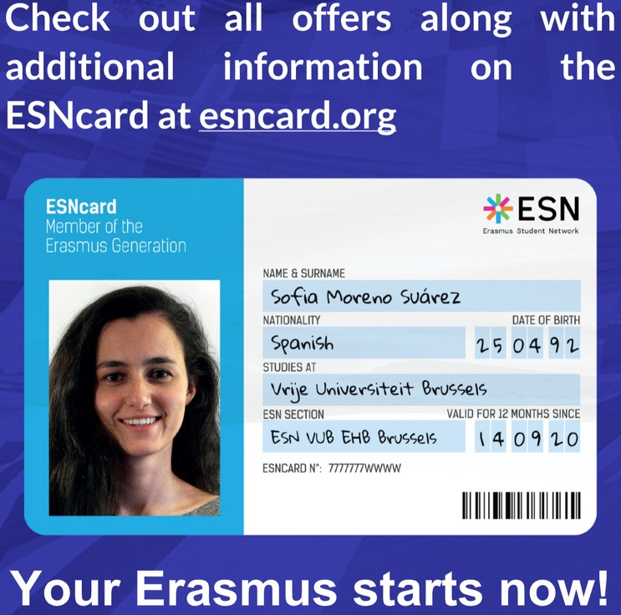
ESNcard
You can buy it in the ESN ELTE office: 1088 Budapest, Múzeum körút 6-8., Youth Building, 3rd floor, room 5-7
OR at our events!
Don't miss out on this huge opportunity!
The best part: after your mobility, you do not have to throw it out because you can use it all over Europe and collect the benefits!

Slide 9
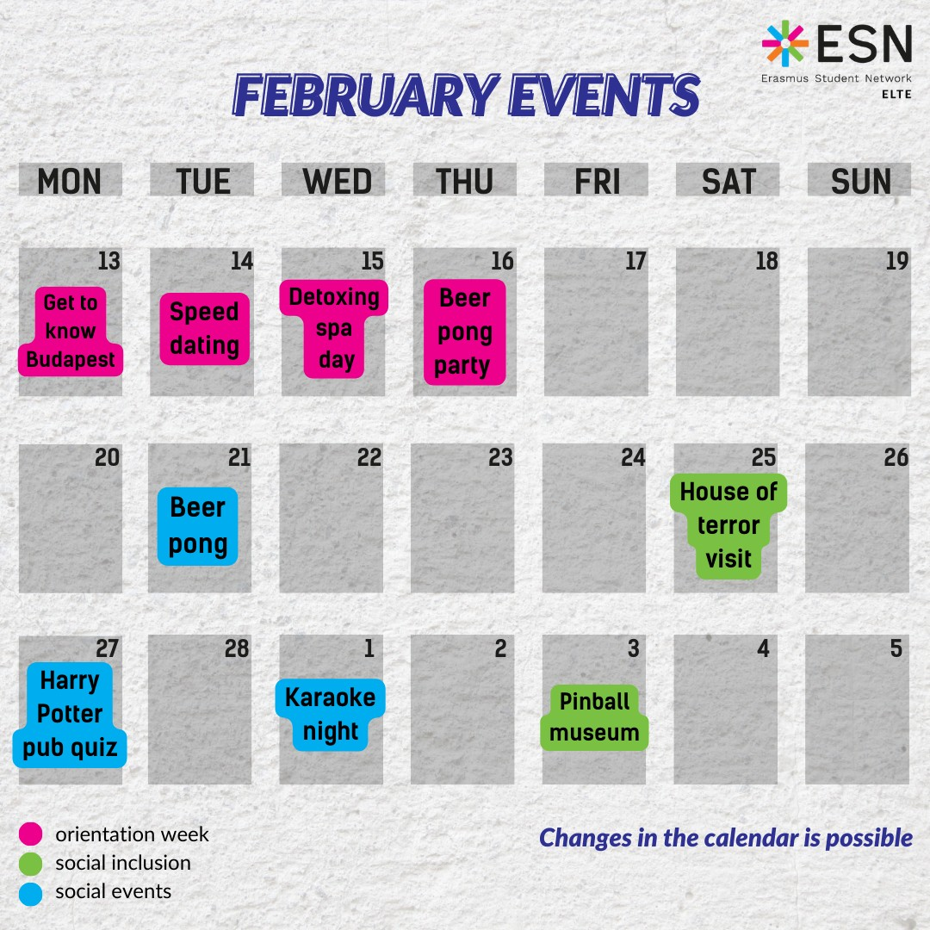
Our upcoming events:

Slide 10
Orientation Week

Slide 11
Hope to see you during the week and the whole semester!!
Come to the events and lets get to know each other!

Slide 12
If you have any questions, contact us anytime:
board@elte.esn.hu
further information:
Facebook: ESN ELTE - Erasmus Student Network ELTE
Instagram: esnelte
WhatsApp groups: links are shared on our pages!

