Slide 2
NEPTUN GUIDE
Call for Erasmus+ Student Mobility Programme
for students of Eötvös Loránd University for the 2021/2022 Academic Year

Slide 3
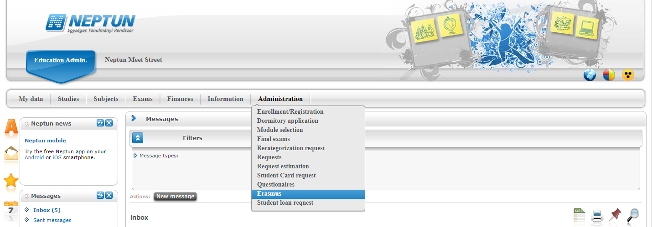
ERASMUS+ APPLICATIONS MUST BE SUBMITTED VIA NEPTUN
1st Step
Log in to the Student web interface of Neptun, and in the Administration menu you will find the word Erasmus

Slide 4
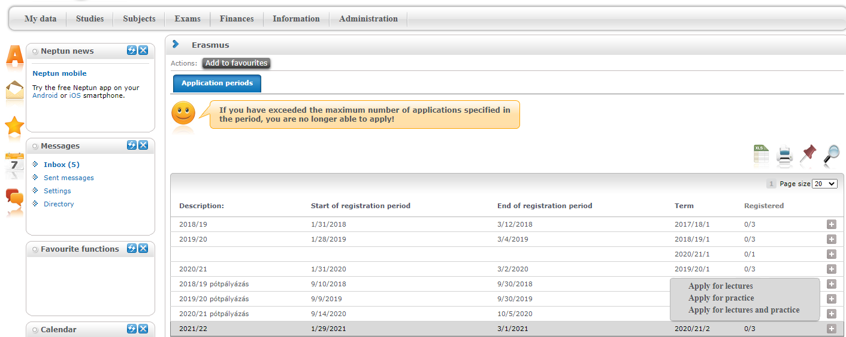
2nd step
Choose the active registration period (2021/22) and click the
plus sign at the end of the line.
There you can choose if you want to apply for lectures
(exchange studies), practice (traineeship) or both.
Notes:
BELEÍRNI! Mindkettőre* Abban az esetben, ha kombinált mobilitást tervez (tanulmányok és szakmai gyakorlat ugyanazon a helyen, megszakítás nélkül). Ha két külön mobilitásról van szó, akkor külön-külön kell jelentkeznie!

Slide 5
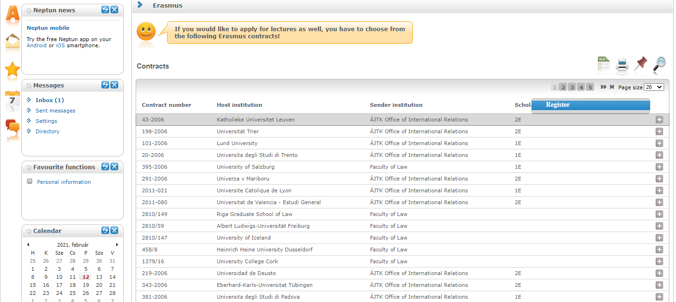
3rd step A
For those applying for exchange studies
Here you can see which partner universities you can apply to from your department.
Choose the host university you would like to apply to. Before making your choice please read through the courses offered at the partner universities.
By clicking on the plus sign at the end of the row you need to click Register to start your application.
If you know that your department has more partner institutions, contact your faculty coordinator. https://www.elte.hu/en/international-offices/faculty-international-offices

Slide 6
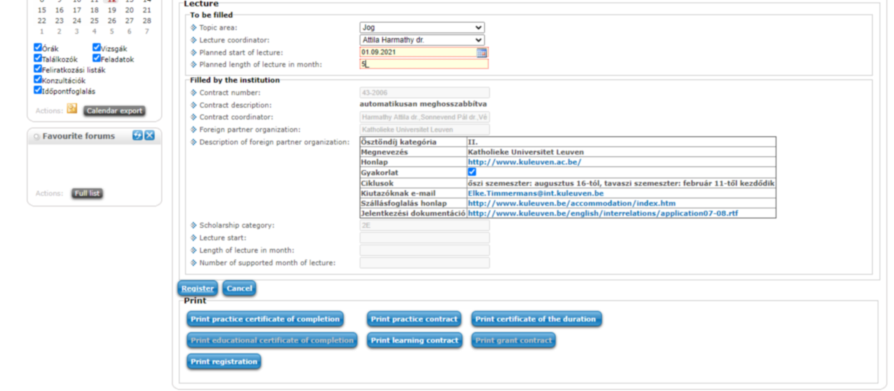
3rd step A (cont.)
After clicking on Register (previous step) you need to give the planned start of lecture and planned lenght of lecture (which is usually 5 months) and click Register again.

Slide 7
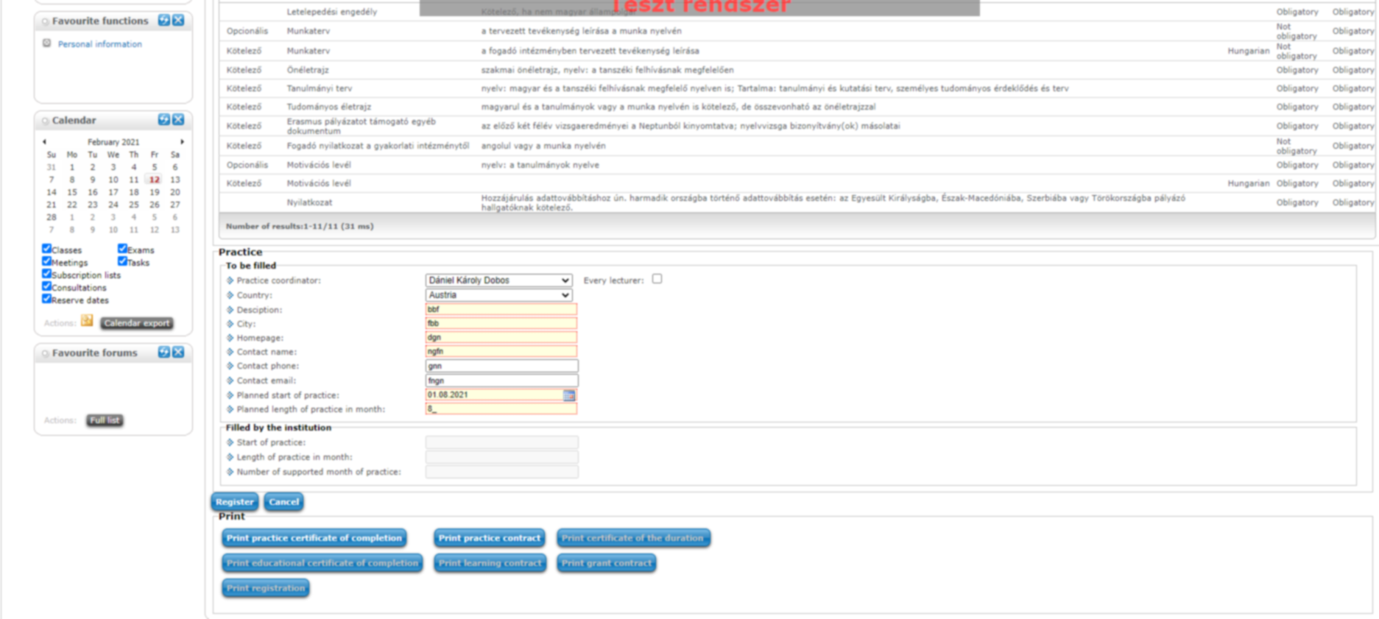
3rd step B
For those applying for traineeships
Answer all the questions below to the best of your knowledge. Give special attention to the planned start of practice and planned length of practice.
You can find the name of your practice coordinator by ticking every lecturer at the end of the line.
Click Register to validate your application.

Slide 8
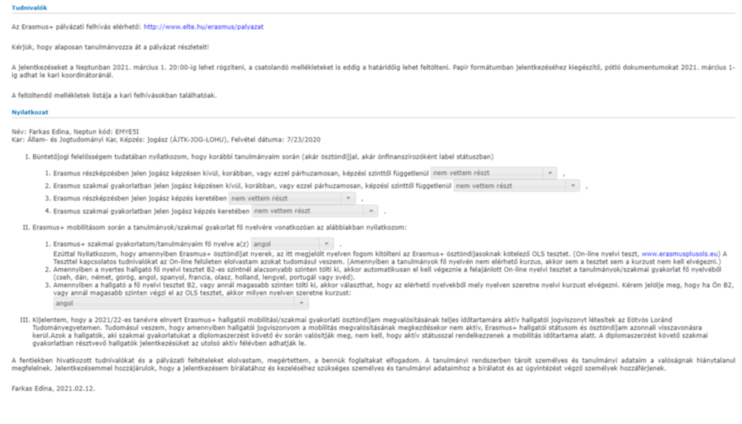
4th step
By clicking the Register button section [Tudnivalók] and [Nyilatkozat] will pop up.
Read it carefully and fill it to the best of your knowledge.Then click the Next button at the bottom.

Slide 9
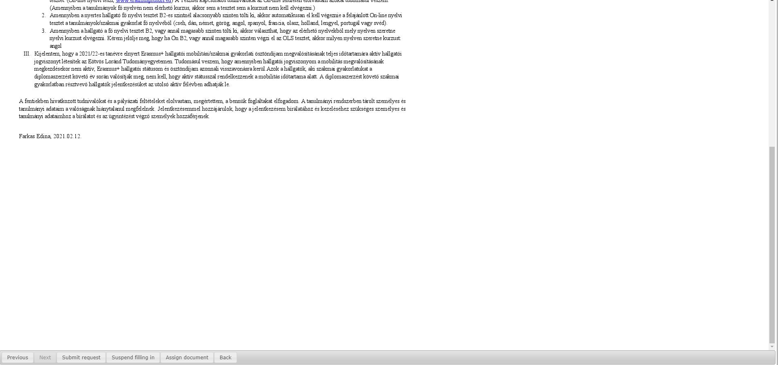
5th step
After clicking the Next button you will be able to submit your request by click the Submit request.

Slide 10
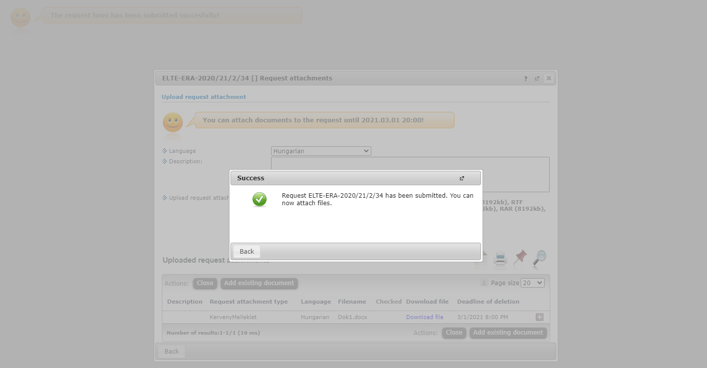
6th step
After that, a pop-up message appears on the window saying that your request has been submitted and that you can attach files to the request.
When you close the message by clicking back, a display serves to attach files will appear. (see: 7th step).
The attachable documents can vary from faculties/departments to faculties/department. Please consult your international coordinator. You can find the list of international coordinators at: https://www.elte.hu/en/outgoing-mobility/erasmus/call-for-application

Slide 11
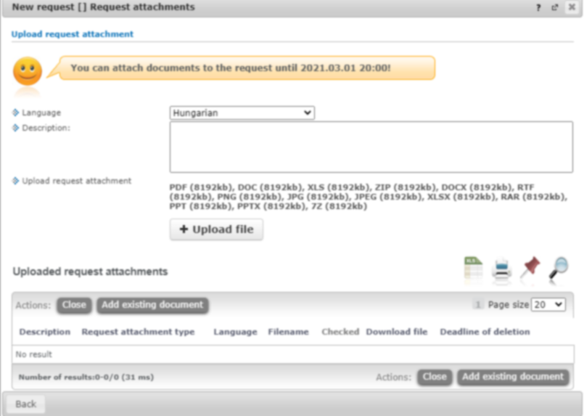
7th step
Here you can attach documents to your request until the application deadline. If you have already uploaded a document you might want to add it with by click Add existing document. To upload new document(s) choose its language, name it in the Description box and click + Upload file.

Slide 12
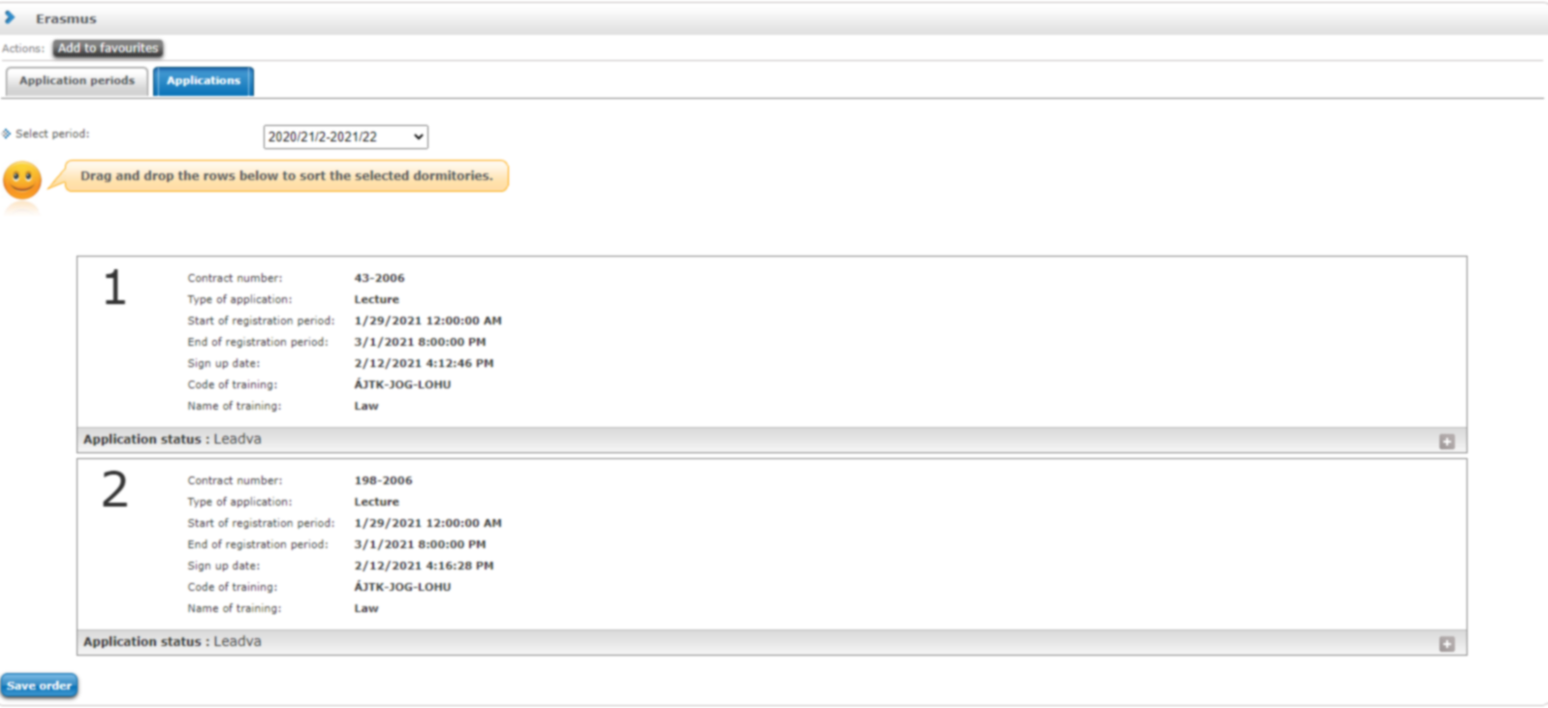
8th step
Your application can be seen at Administration/Erasmus/Applications.
Do not forget that you can apply up to 3 places by order of preference.

Slide 13
APPLICATION SUBMITTED
To successful application, please read the call for application carefully:
www.elte.hu/en → Education → Outgoing mobility→ Erasmus+ → Call for application
https://www.elte.hu/en/outgoing-mobility/erasmus/call-for-application;
and join our Erasmus+ Information Workshops, which dates can be found in the linked website.
Good luck on your application!

Slide 14
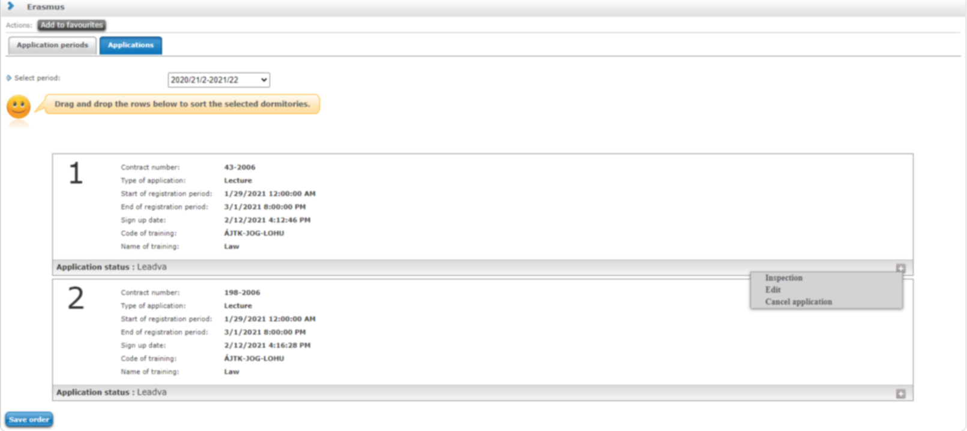
(+ Optional steps)
Until the deadline for application (1 March 2021 8pm) you can change the order by drag and drop the boxes.
Until the deadline for application (1 March 2021 8pm) you can edit and cancel your application. To do so click the + sign and choose Edit or Cancel application.
To check the application click Inspection.

