Slide 1

Bacterial evolutionary and memetic algorithms and their applications in simulations
Szilárd Kovács Supervisor:
PhD Student, Dept AI János Botzheim
kovacsszilard@inf.elte.hu
ELTE – Chung Ang Artificial Intelligence Conference Budapest, 2023. 07. 18.

Slide 2

Szilárd Kovács - Bacterial evolutionary and memetic algorithms and their applications in simulations
Structure of the presentation
Optimization and modeling
  Main Challenges
  Bacterial Evolutionary Algorithm
  Bacterial Memetic Algorithm
Applications
  Sensor placement
  Model identification
  Dart throwing robot
  Traffic optimization
Summary
Szilárd Kovács - Bacterial evolutionary and memetic algorithms and their applications in simulations
2023. 07. 19.
2

Slide 3
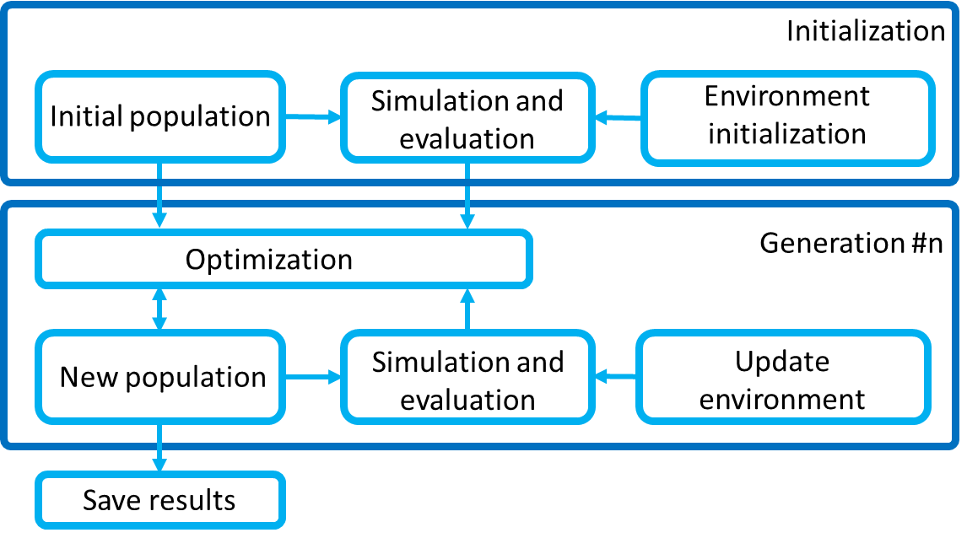
Optimization and modeling
Applications
Summary
References
Simulation based optimization
Environment
Model with parameters
Simulation and Scoring
Optimization
Szilárd Kovács - Bacterial evolutionary and memetic algorithms and their applications in simulations
2023. 07. 19.
3

Slide 4
Optimization and modeling
Applications
Summary
References
Why Bacterial Evolutionary Algorithm?
Long Simulation time →
Population based (parallel)
Measurement noise and simulation stability → Communication, Robust
High dimensionality
→ Task/Dimension separation
Cross-relation, Nonlinearity → Randomness
Initial population
Best solutions
Stop criteria?
Bacterial mutation
Gene transfer
Szilárd Kovács - Bacterial evolutionary and memetic algorithms and their applications in simulations
2023. 07. 19.
4

Slide 5
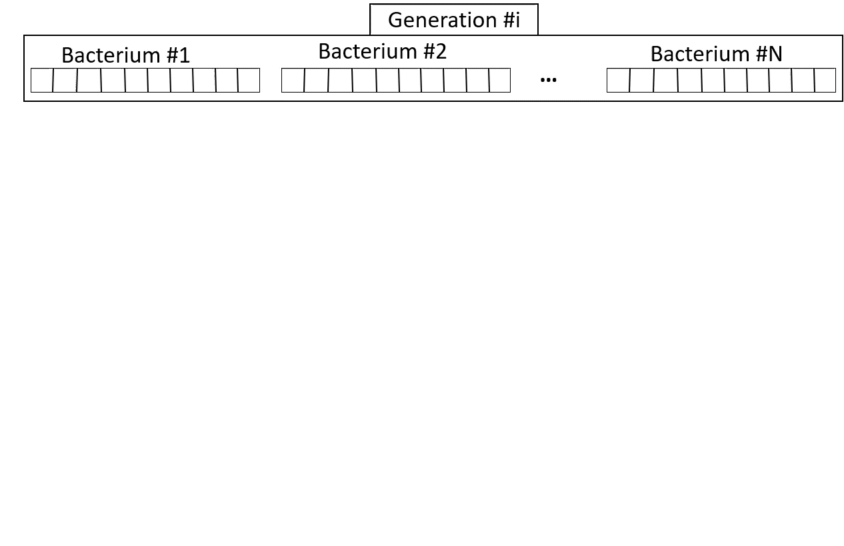
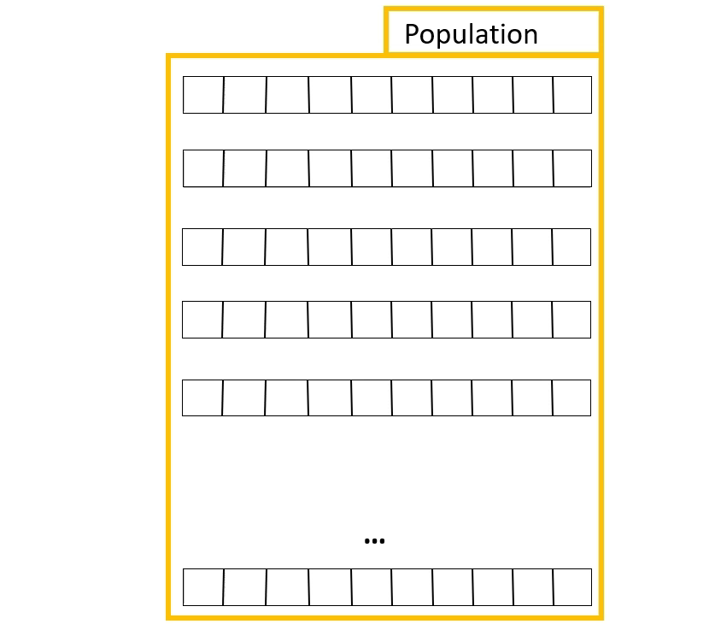
Optimization and modeling
Applications
Summary
References
Bacterial Evolutionary Algorithm
Bacterial mutation
Gene transfer
Szilárd Kovács - Bacterial evolutionary and memetic algorithms and their applications in simulations
2023. 07. 19.
5

Slide 6
Optimization and modeling
Optimization and modeling
Optimization
Summary
Summary
Summary
References
References
Applications
References
Modeling and optimization
Applications
Why Bacterial Memetic Algorithm?
Faster convergence
Methods:
  Population-based gradient
  Traditional gradient
Adaptive step size methods:
  Adaptive Hill Climbing
  ADAM
  Levenberg Marquardt Alg.
Initial population
Best solutions
Stop criteria?
Bacterial mutation
(Local search)
Local search
Gene transfer
Szilárd Kovács - Bacterial evolutionary and memetic algorithms and their applications in simulations
2023. 07. 19.
6

Slide 7
Sensor Placement
Kutatási téma
Elvégzett munka
Összefoglalás
Referenciák
Szilárd Kovács - Bacterial evolutionary and memetic algorithms and their applications in simulations
Szilárd Kovács - Bacterial evolutionary and memetic algorithms and their applications in simulations
2023. 07. 19.
7

Slide 8

Optimization and modeling
Applications
Summary
References
Optical Sensor Placement
Task:
Area and boarder surveillance
Sensors:
Camera (RGB, Mono, Infra, Multispectral)
Goal:
Maximize detection,
Reducing the number of sensors,
Recognition
[1]
Szilárd Kovács - Bacterial evolutionary and memetic algorithms and their applications in simulations
2023. 07. 19.
8

Slide 9
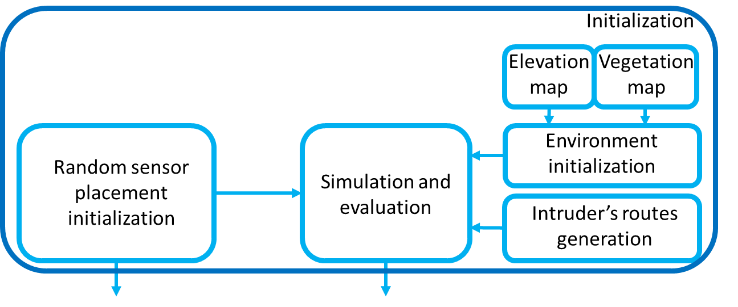
Optimization and modeling
Applications
Summary
References
Optical Sensor Placement
Environment
Modeling:
Terrain map,
Vegetation map,
Inhomogeneous environment
Sensing:
Line of sight model,
Background effect,
Signal-to-noise ratio approach
Simulation:
Monte Carlo method,
Update environment
Initialization
Szilárd Kovács - Bacterial evolutionary and memetic algorithms and their applications in simulations
2023. 07. 19.
9

Slide 10
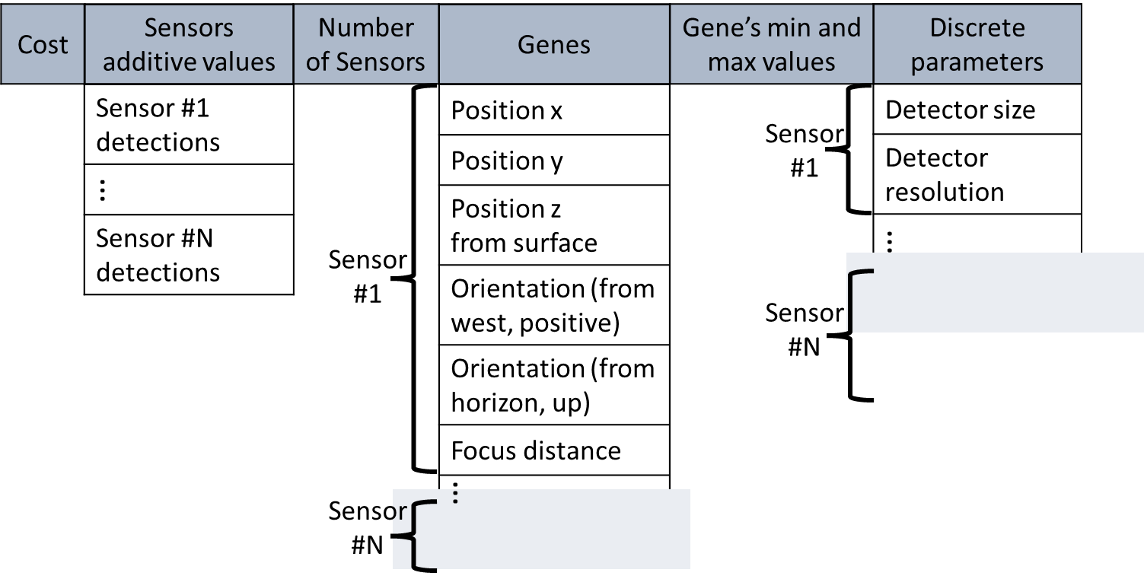
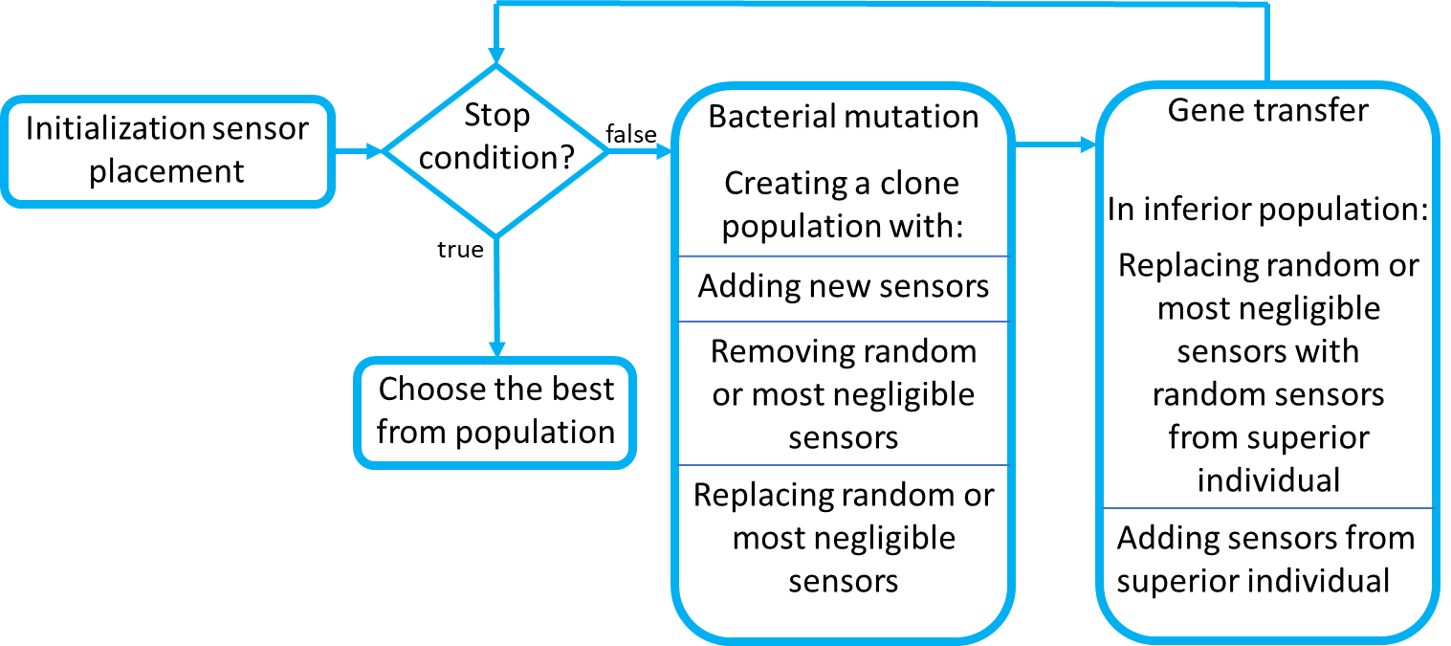
Optimization and modeling
Applications
Summary
References
Optical Sensor Placement
Individuals
Optimization:
Bacterial Evolutionary Algorithm
Parameters:
Coordinates,
Horizontal-, Vertical angle,
Focus distance, Resolution
Cost function: (global and individual)
Maximize detection,
Reducing the number of sensors,
Stepped design, additional value
Optimization
Szilárd Kovács - Bacterial evolutionary and memetic algorithms and their applications in simulations
2023. 07. 19.
10

Slide 11
Optimization and modeling
Kutatási téma
Összefoglalás
Summary
Referenciák
Elvégzett munka
References
Applications
Optical Sensor Placement
Detection strength
Results
Stepped cost function
Ref.: Kovács Sz., Bolemányi B., Botzheim J.: Placement of Optical Sensors in 3D Terrain Using a Bacterial Evolutionary Algorithm., Sensors 2022, 22, 1161.https://doi.org/10.3390/s22031161
Szilárd Kovács - Bacterial evolutionary and memetic algorithms and their applications in simulations
2023. 07. 19.
11

Slide 12
Optimization and modeling
Kutatási téma
Összefoglalás
Summary
Referenciák
Elvégzett munka
References
Applications
Optical Sensor Placement
Different solutions
Ref.: Kovács Sz., Bolemányi B., Botzheim J.: Placement of Optical Sensors in 3D Terrain Using a Bacterial Evolutionary Algorithm., Sensors 2022, 22, 1161.https://doi.org/10.3390/s22031161
Szilárd Kovács - Bacterial evolutionary and memetic algorithms and their applications in simulations
2023. 07. 19.
12

Slide 13
Darts Playing Robot I.
Kutatási téma
Elvégzett munka
Összefoglalás
Referenciák
Szilárd Kovács - Bacterial evolutionary and memetic algorithms and their applications in simulations
Identification
Szilárd Kovács - Bacterial evolutionary and memetic algorithms and their applications in simulations
2023. 07. 19.
13

Slide 14
Optimization and modeling
Kutatási téma
Összefoglalás
Summary
Referenciák
Elvégzett munka
References
Applications
Darts Playing Robot
Task:
Accurate targeting
Scatter reduction
Bounce reduction
Sensors:
Cameras (RGB)
Boundaries:
Real-life experimenting is dangerous
Kuka KR 6 Robot
Darts-table
Darts model
Releasing parameters
Robot model
Robot parameters
Optimization steps
Szilárd Kovács - Bacterial evolutionary and memetic algorithms and their applications in simulations
2023. 07. 19.
14

Slide 15
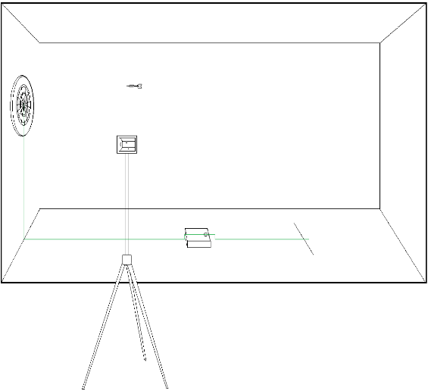
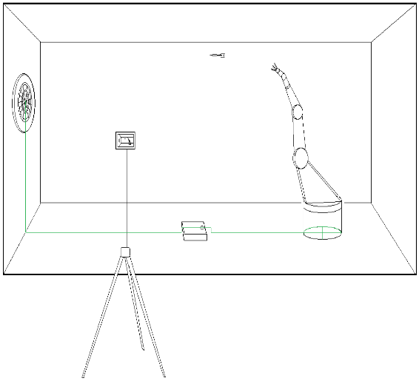

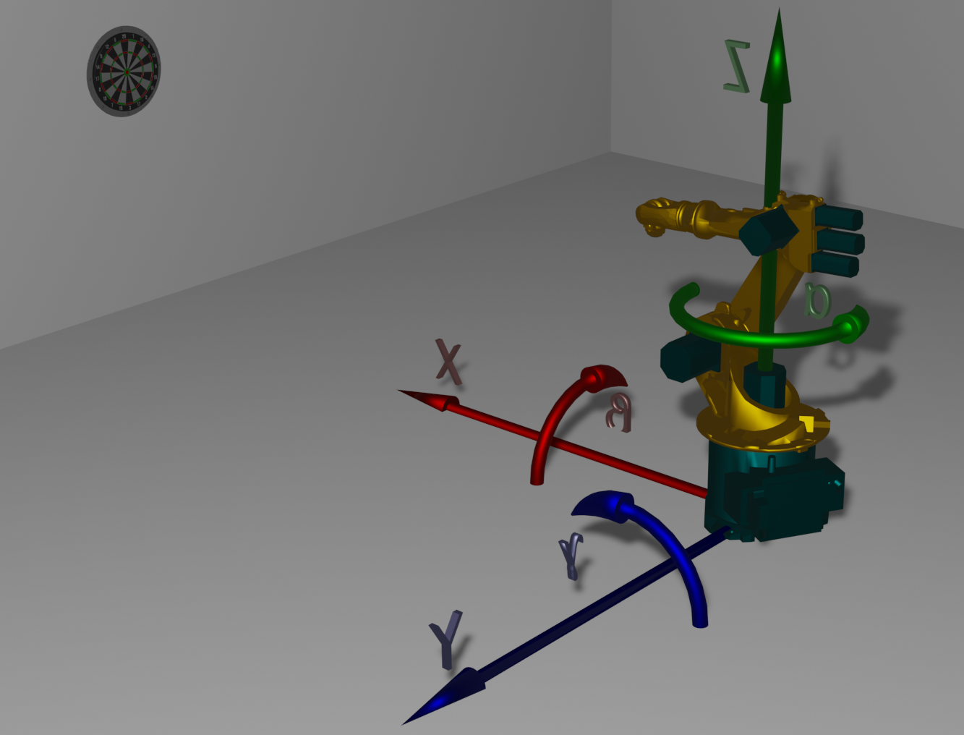
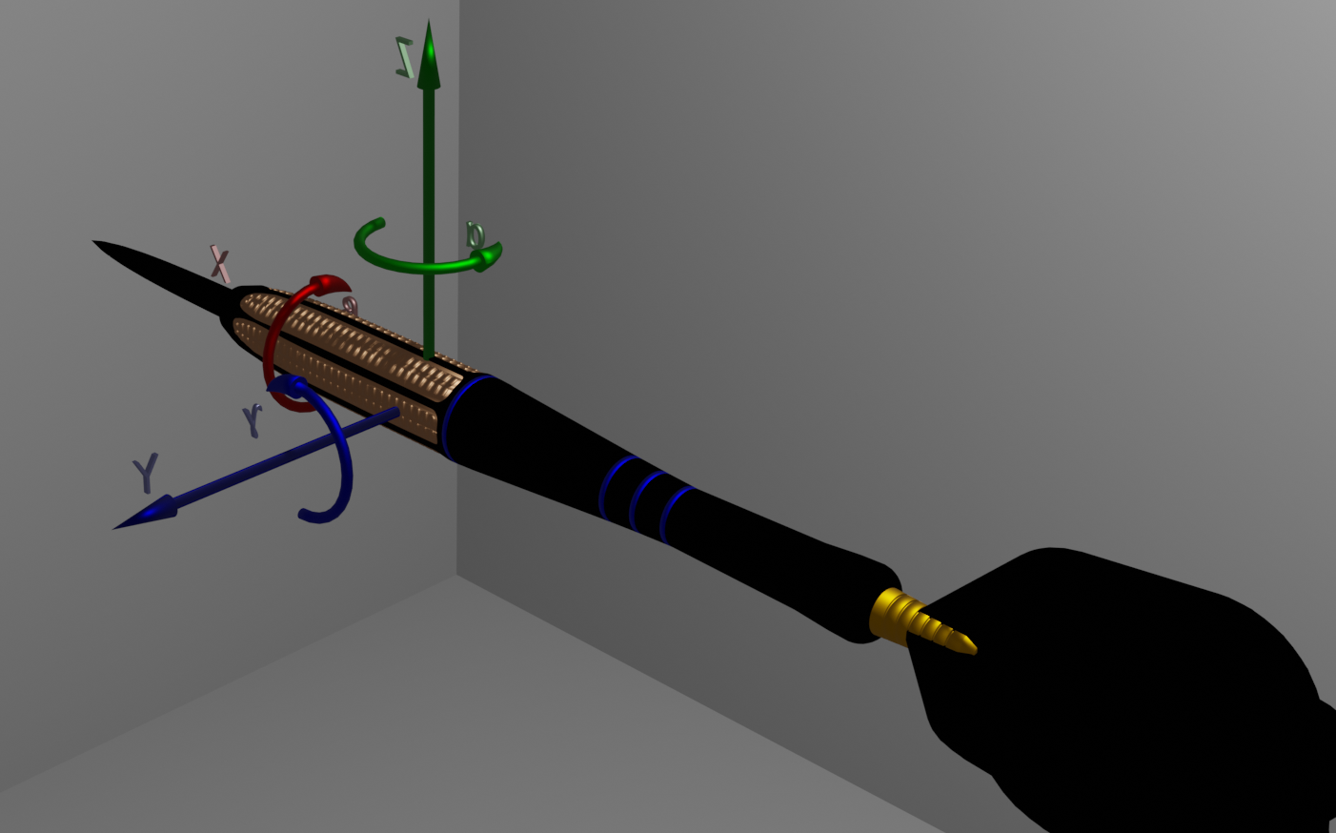
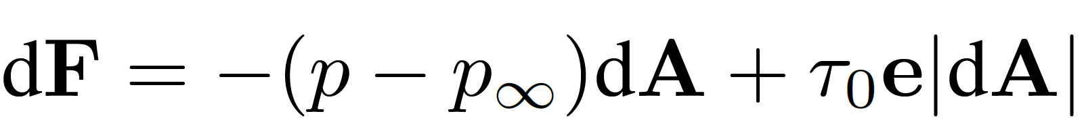
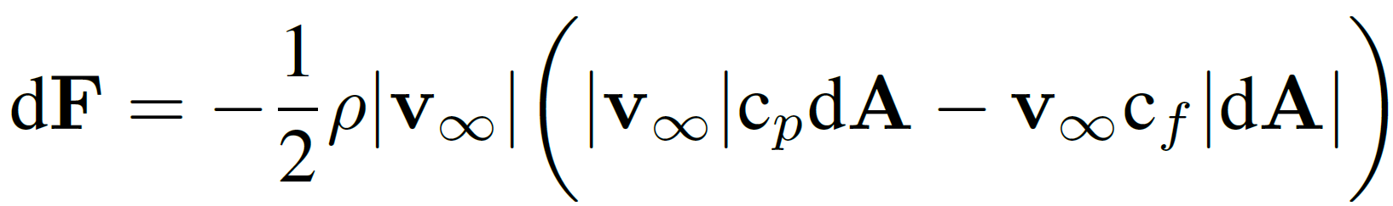
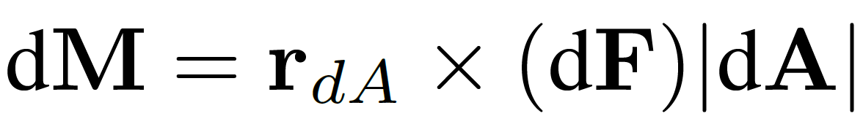
Optimization and modeling
Kutatási téma
Összefoglalás
Summary
Referenciák
Elvégzett munka
References
Applications
Robot and dart identification
Modeling:
Measurement (2 camera setup)
Dart model
Robot model
Measurement arrangement
Forces:
‘Form-’ és ‘friction drag’
With form factors:
torques:
Robot model
Dart model
Base formulas
Szilárd Kovács - Bacterial evolutionary and memetic algorithms and their applications in simulations
2023. 07. 19.
15

Slide 16
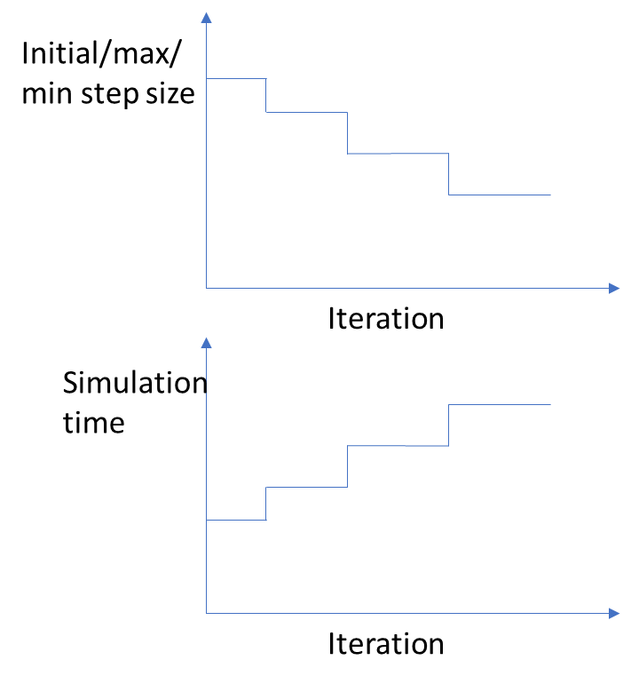
Optimization and modeling
Kutatási téma
Összefoglalás
Summary
Referenciák
Elvégzett munka
References
Applications
Dart Identification
Optimization:
Bacterial Memetic Algorithm
Parameters:
Drag coefficients,
Weight distribution
Cost function:
5 Degree of Freedom (DoF)
Bacterial Memetic Algorithm
Initial population
Best solutions
Stop criteria?
Scheduling learning
Bacterial mutation
(Local search)
Local search
Gene transfer
Szilárd Kovács - Bacterial evolutionary and memetic algorithms and their applications in simulations
2023. 07. 19.
16

Slide 17
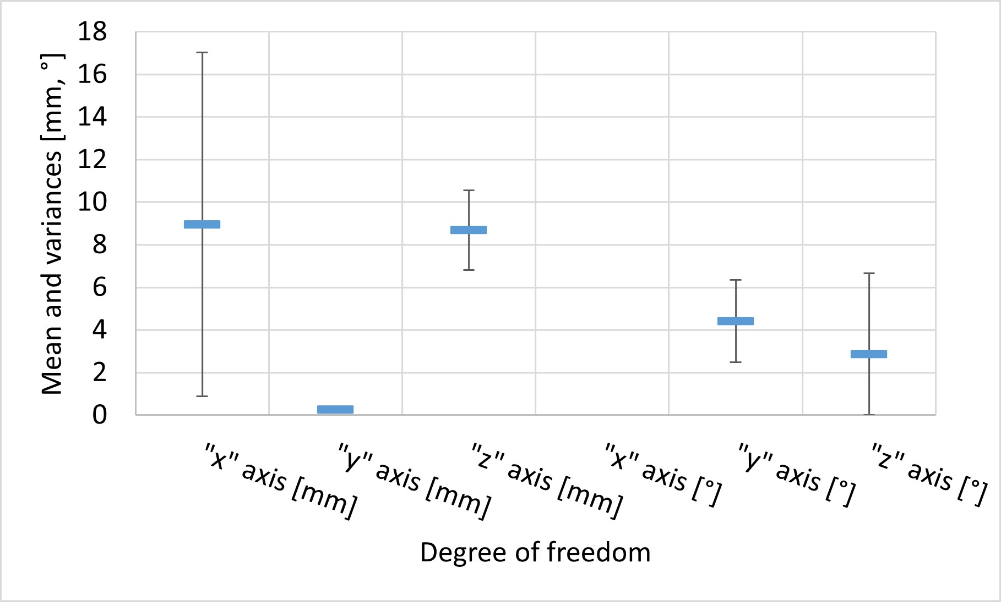
Optimization and modeling
Applications
Summary
References
Dart Identification
Results:
Varying simulation time step
Changing simulation length
Early stopping
5 DoF:
* : Measurements
- : Simulation
Kovács Sz.: Dartstű mozgásának vizsgálata dartsozó robothoz. OGÉT 2020, Kolozsvár, Románia, 2020.04.25., Kolozsvár, pp. 321-324, ISSN 2668-9685. (2020).
Szilárd Kovács - Bacterial evolutionary and memetic algorithms and their applications in simulations
2023. 07. 19.
17

Slide 18
Darts Playing Robot II.
Kutatási téma
Elvégzett munka
Összefoglalás
Referenciák
Szilárd Kovács - Bacterial evolutionary and memetic algorithms and their applications in simulations
Throw
Szilárd Kovács - Bacterial evolutionary and memetic algorithms and their applications in simulations
2023. 07. 19.
18

Slide 19
Optimization and modeling
Applications
Summary
References
Darts Playing Robot
Optimization:
Bacterial Memetic Algorithm
Connection between simulation and optimization
Parameters:
Robot parameters
Goal:
Throwing style
Arrival distance
Angle of arrival
Kuka KR 6 Robot
Positional cost
Angular cost
Szilárd Kovács - Bacterial evolutionary and memetic algorithms and their applications in simulations
2023. 07. 19.
19

Slide 20
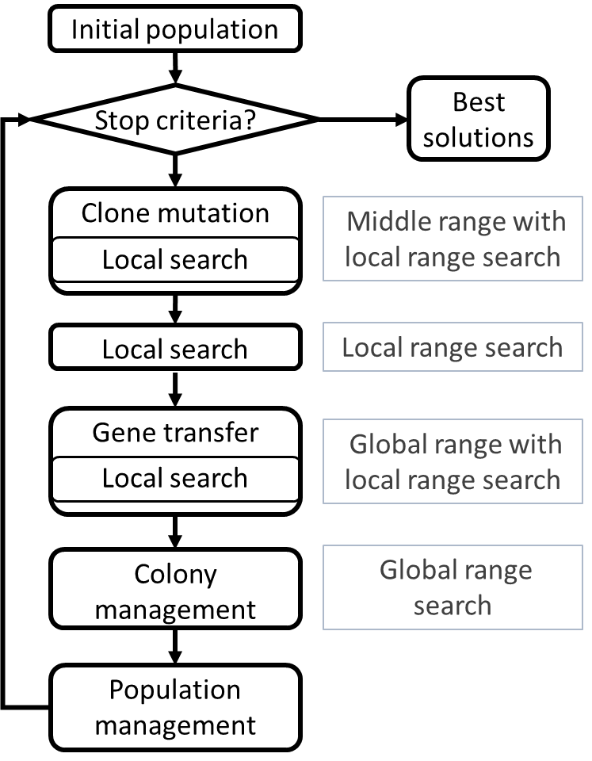
Optimization and modeling
Applications
Summary
References
Colonial Bacterial Memetic Algorithm
Structure of CBMA
Structure of BMA
Initial population
Best solutions
Stop criteria?
Bacterial mutation
(Local search)
Local search
Gene transfer
Szilárd Kovács - Bacterial evolutionary and memetic algorithms and their applications in simulations
2023. 07. 19.
20

Slide 21
Optimization and modeling
Kutatási téma
Összefoglalás
Summary
Referenciák
Elvégzett munka
References
Applications
Darts Playing Robot
Results
Angle of arrival
Throwing
Throwing style
Szilárd Kovács - Bacterial evolutionary and memetic algorithms and their applications in simulations
2023. 07. 19.
21
Notes:
Monte Carlo módszer – még később a szimuláció és optimalizáció kapcsolata

Slide 22
Optimization and modeling
Applications
Summary
References
Darts Playing Robot
Comparison based on single evaluation
Results
Confusion matrix
Comparison based on batch evaluation
Szilárd Kovács - Bacterial evolutionary and memetic algorithms and their applications in simulations
2023. 07. 19.
22

Slide 23
Traffic Optimization
Kutatási téma
Elvégzett munka
Összefoglalás
Referenciák
Szilárd Kovács - Bacterial evolutionary and memetic algorithms and their applications in simulations
Szilárd Kovács - Bacterial evolutionary and memetic algorithms and their applications in simulations
2023. 07. 19.
23

Slide 24
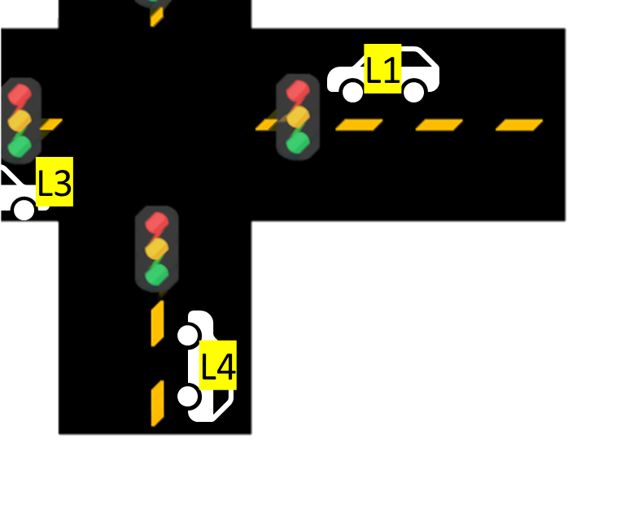
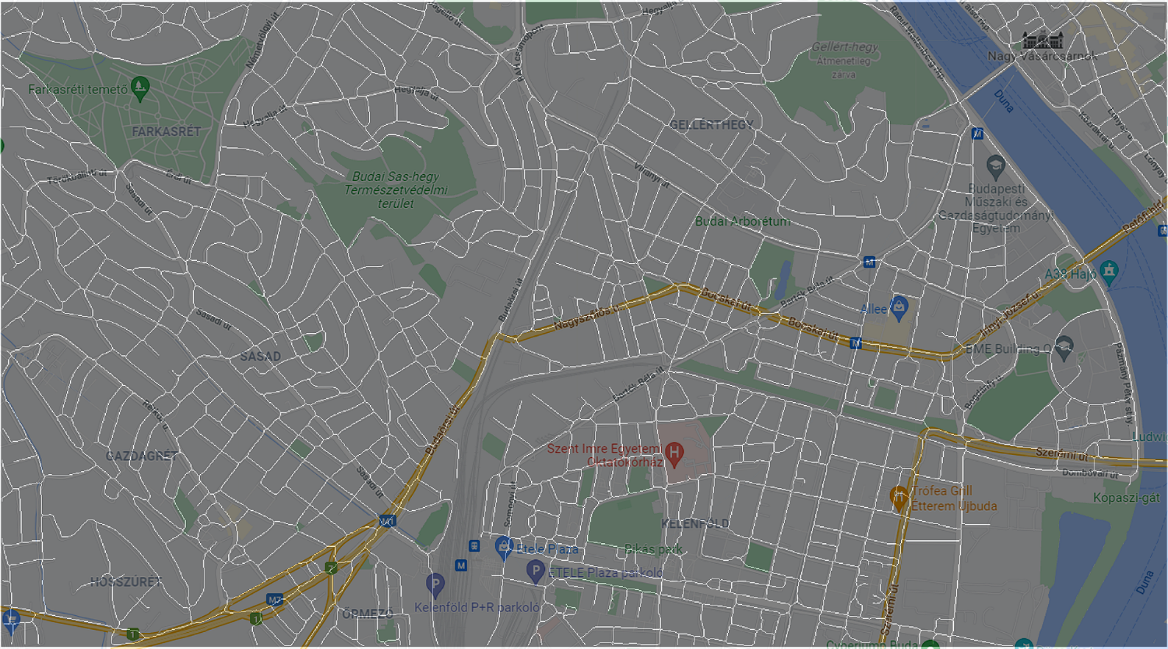
Optimization and modeling
Applications
Summary
References
Traffic Optimization
Task:
Timing and switching sequence of traffic lights
Modern software uses either local search or genetic algorithms for real-time traffic optimization
Goal:
Reducing waiting time
Decreasing emission
Szilárd Kovács - Bacterial evolutionary and memetic algorithms and their applications in simulations
2023. 07. 19.
24
Notes:
Carbon-, Nitrogen dioxide

Slide 25
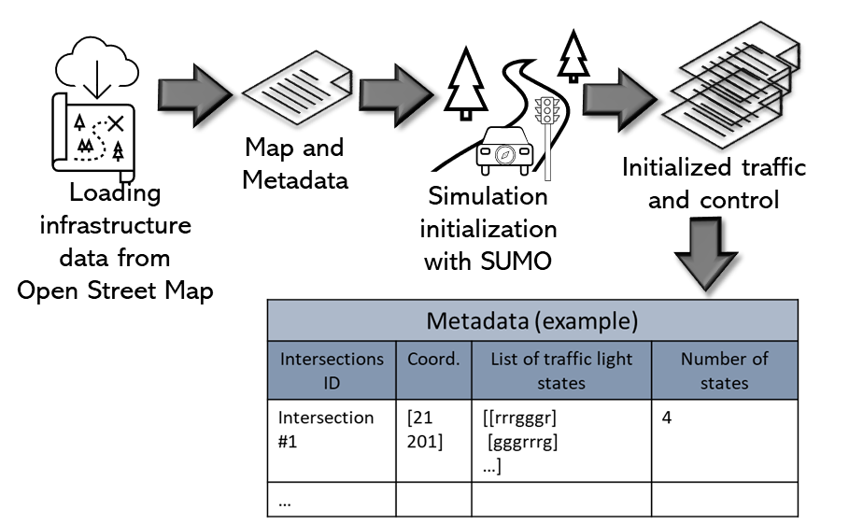
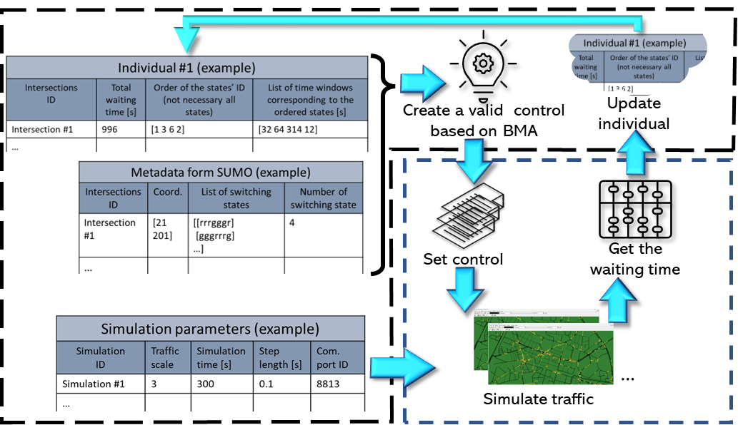
Optimization and modeling
Applications
Summary
References
Traffic Optimization
Modeling and Simulation
Data collection and Initialization
Simulation and Optimization loop
Szilárd Kovács - Bacterial evolutionary and memetic algorithms and their applications in simulations
2023. 07. 19.
25

Slide 26
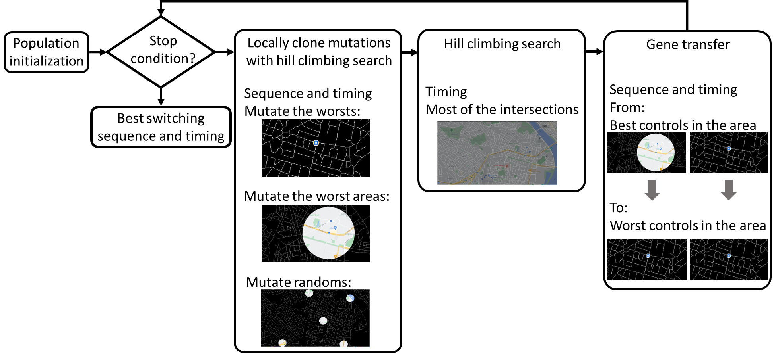
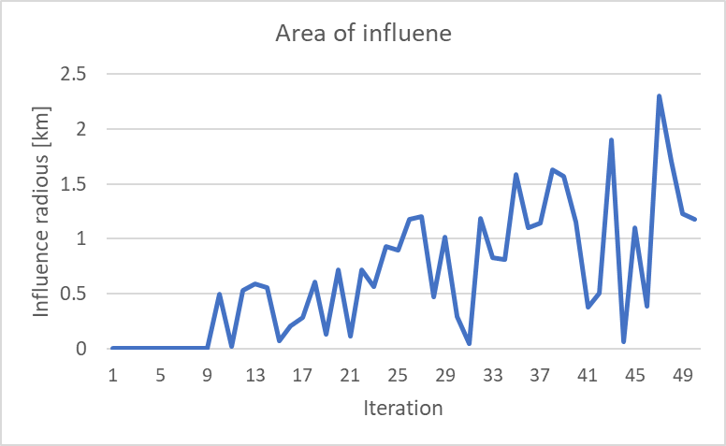
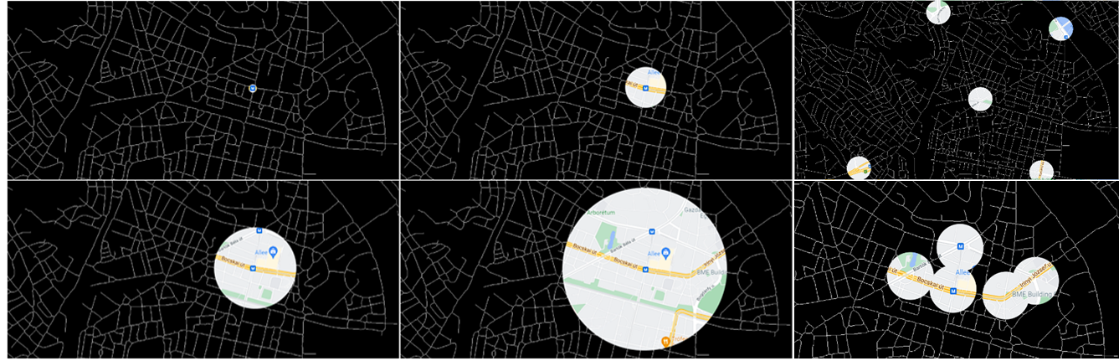
Optimization and modeling
Applications
Summary
References
Traffic Optimization
Optimization
A distance-based Bacterial Memetic Algorithm for optimization on maps
Szilárd Kovács - Bacterial evolutionary and memetic algorithms and their applications in simulations
2023. 07. 19.
26

Slide 27
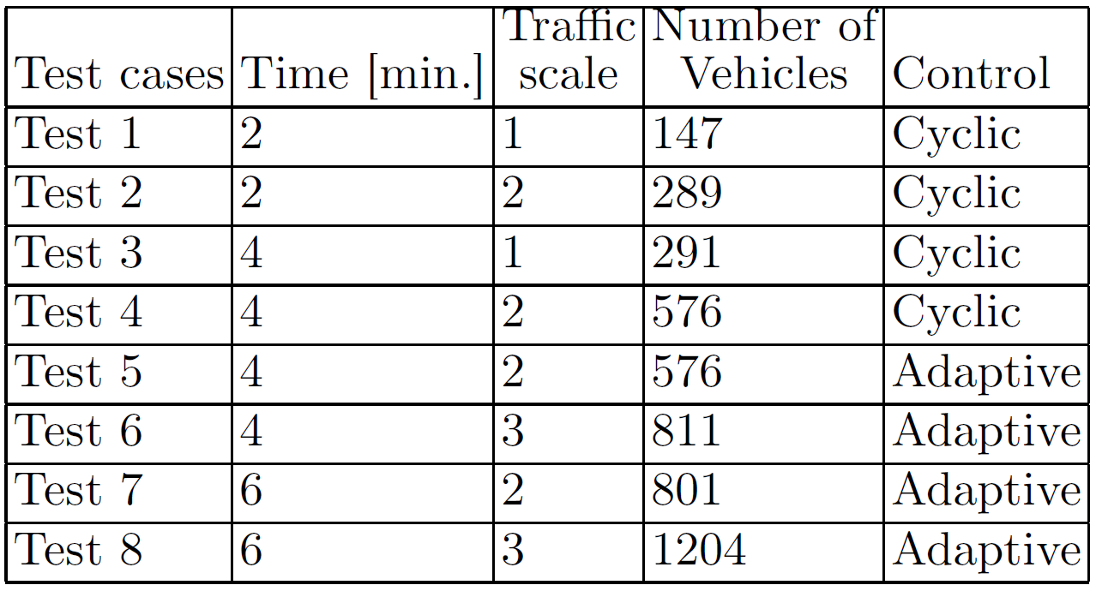
Optimization and modeling
Applications
Summary
References
Traffic Optimization
Cyclic
Results
Tests
Adaptive
Szilárd Kovács - Bacterial evolutionary and memetic algorithms and their applications in simulations
2023. 07. 19.
27

Slide 28
Summary
Kutatási téma
Elvégzett munka
Összefoglalás
Referenciák
Szilárd Kovács - Bacterial evolutionary and memetic algorithms and their applications in simulations
Szilárd Kovács - Bacterial evolutionary and memetic algorithms and their applications in simulations
2023. 07. 19.
28

Slide 29
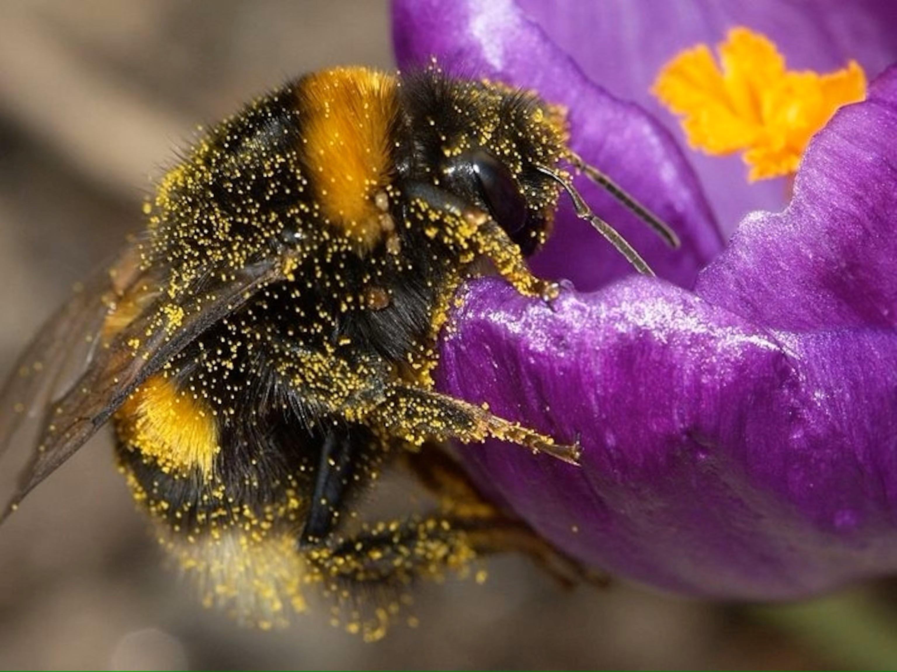
Optimization and modeling
Applications
Summary
References
Summary
The model-based optimization is a challenging task
Long simulation time
Identification and noisy measurement
Stability of the simulation
Cost function construction
Coevolution between the simulation and optimization!
[2]
Szilárd Kovács - Bacterial evolutionary and memetic algorithms and their applications in simulations
2023. 07. 19.
29

Slide 30
Thank You for your attention!
Szilárd Kovács - Bacterial evolutionary and memetic algorithms and their applications in simulations
Questions?
Szilárd Kovács - Bacterial evolutionary and memetic algorithms and their applications in simulations
2023. 07. 19.
30

Slide 31
Szilárd Kovács - Bacterial evolutionary and memetic algorithms and their applications in simulations
References
[1] https://c.wallhere.com/photos/6f/a5/nature_trees_hills_mist_landscape_field-263005.jpg!d (last visited 2023. 01. 04.)
[2] https://www.nationalgeographic.com/science/article/bees-can-sense-the-electric-fields-of-flowers (last visited 2023. 07. 14.)
Szilárd Kovács - Bacterial evolutionary and memetic algorithms and their applications in simulations
2023. 07. 19.
31

